Slide 1

EFFECTIVE SHIPMENT SCHEDULING
Rashon Manning

Slide 2

ABOUT ME
About

Slide 3

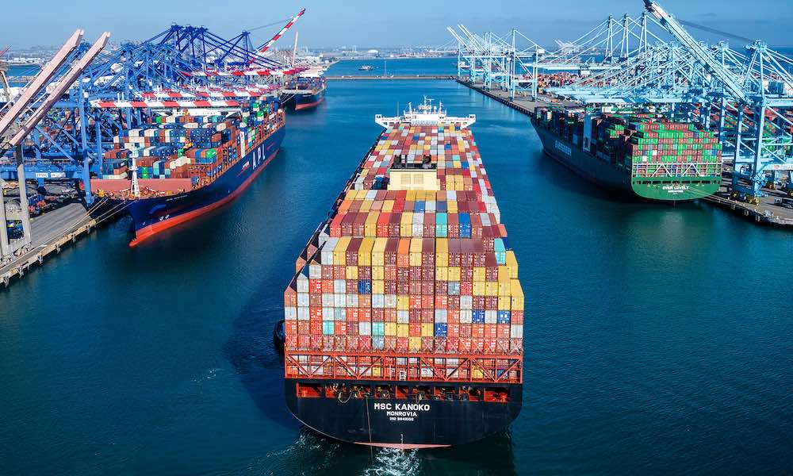
PROBLEM
Problem
Increased turnaround time
Businesses have noticed an increased turn around time when attempting to dock at the five busiest ports
Lost cargo
Businesses have noticed an unexplained significant increased in loss cargo when traversing through the Pacific Ocean

Slide 4

HYPOTHESIS
Docking at specific time of week/year
Decreased turnaround time and less lost cargo

Slide 5
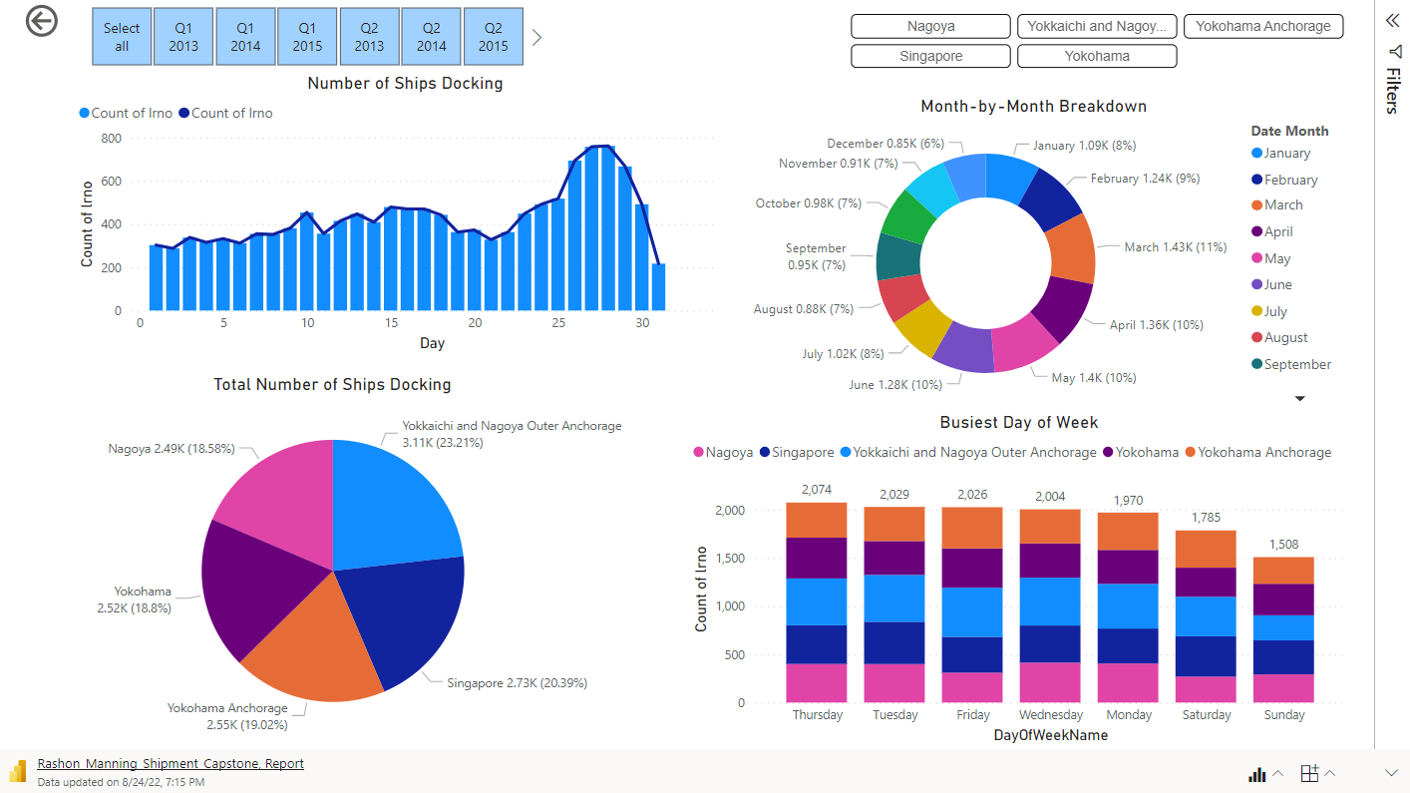

Slide 6

SUMMARY
summary

Slide 7

Thank You
Rashon Manning
555-333-1111
Rashon.Manning@Divergence.One

